Slide 1



Slide 2
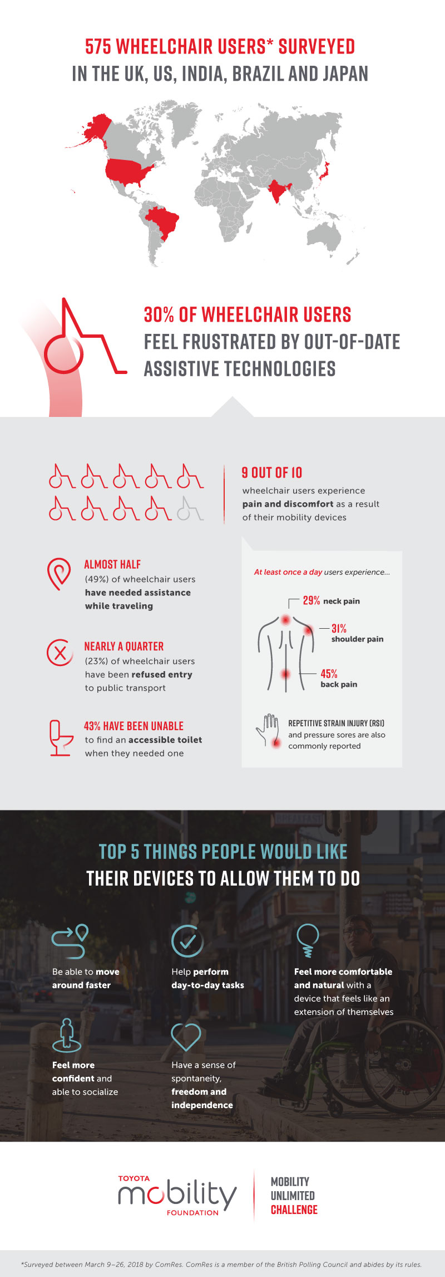

Slide 4
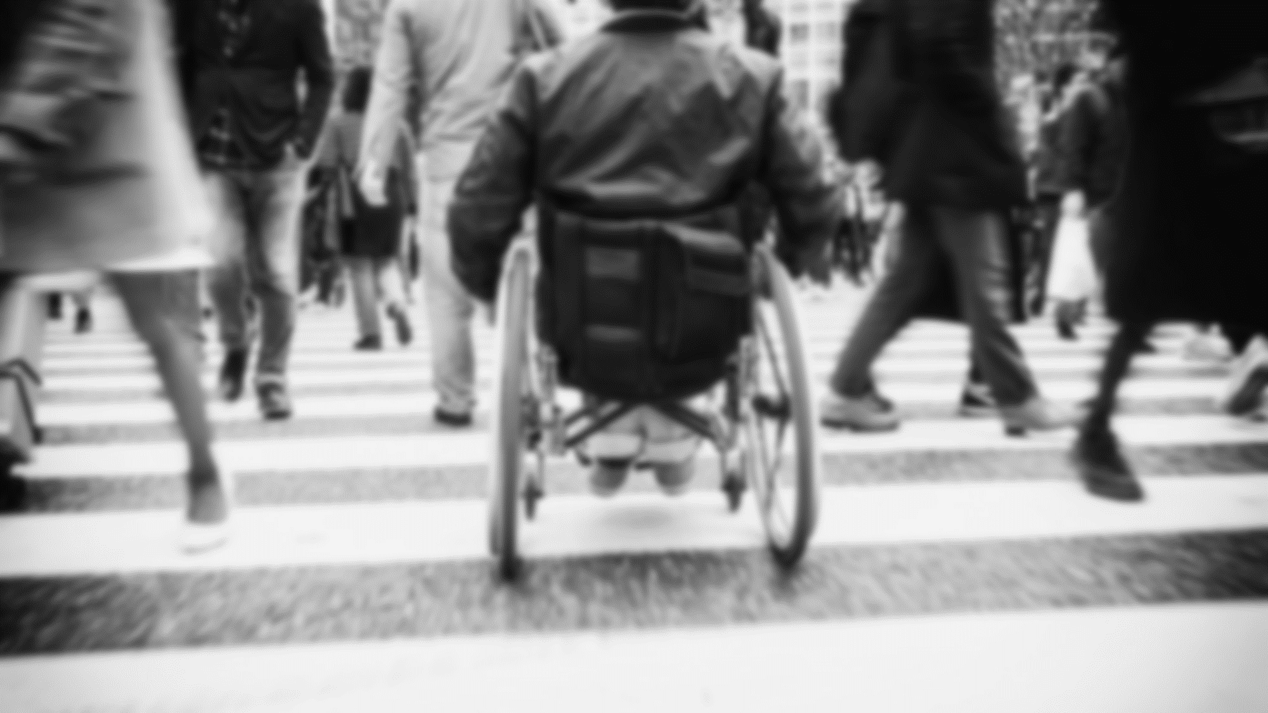

“Providing half the functionality, at a quarter of the price”

Slide 5
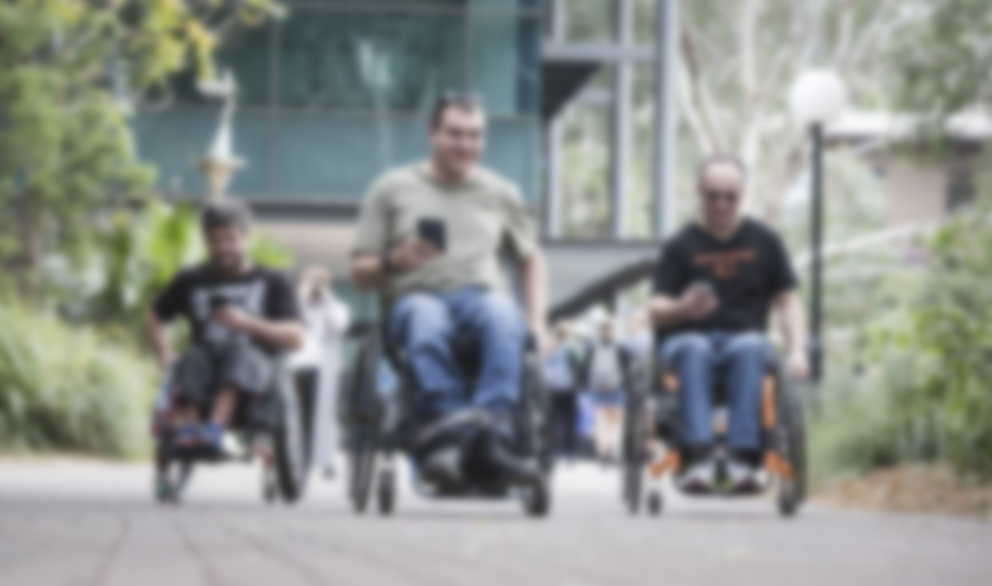




VALUE PROPOSITIONS
LOW COST
DEDICATED PATH
REDUCE PAIN

Slide 6

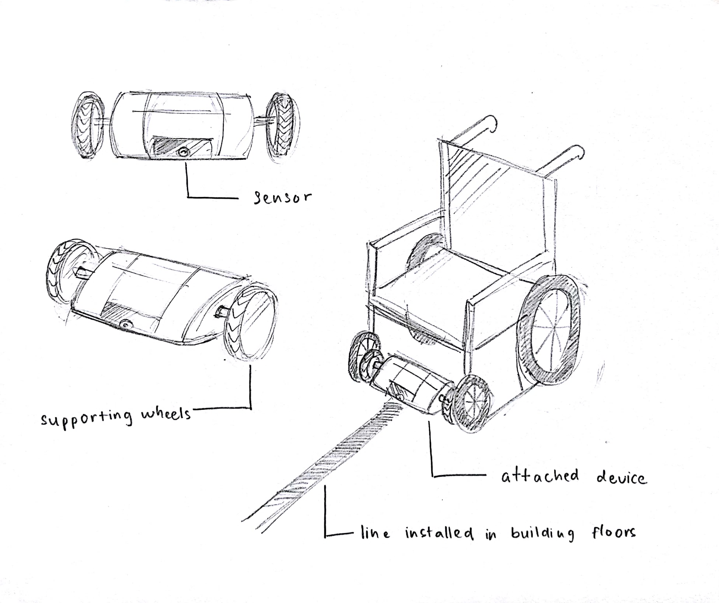

PRODUCT SCHEMATICS

Slide 7
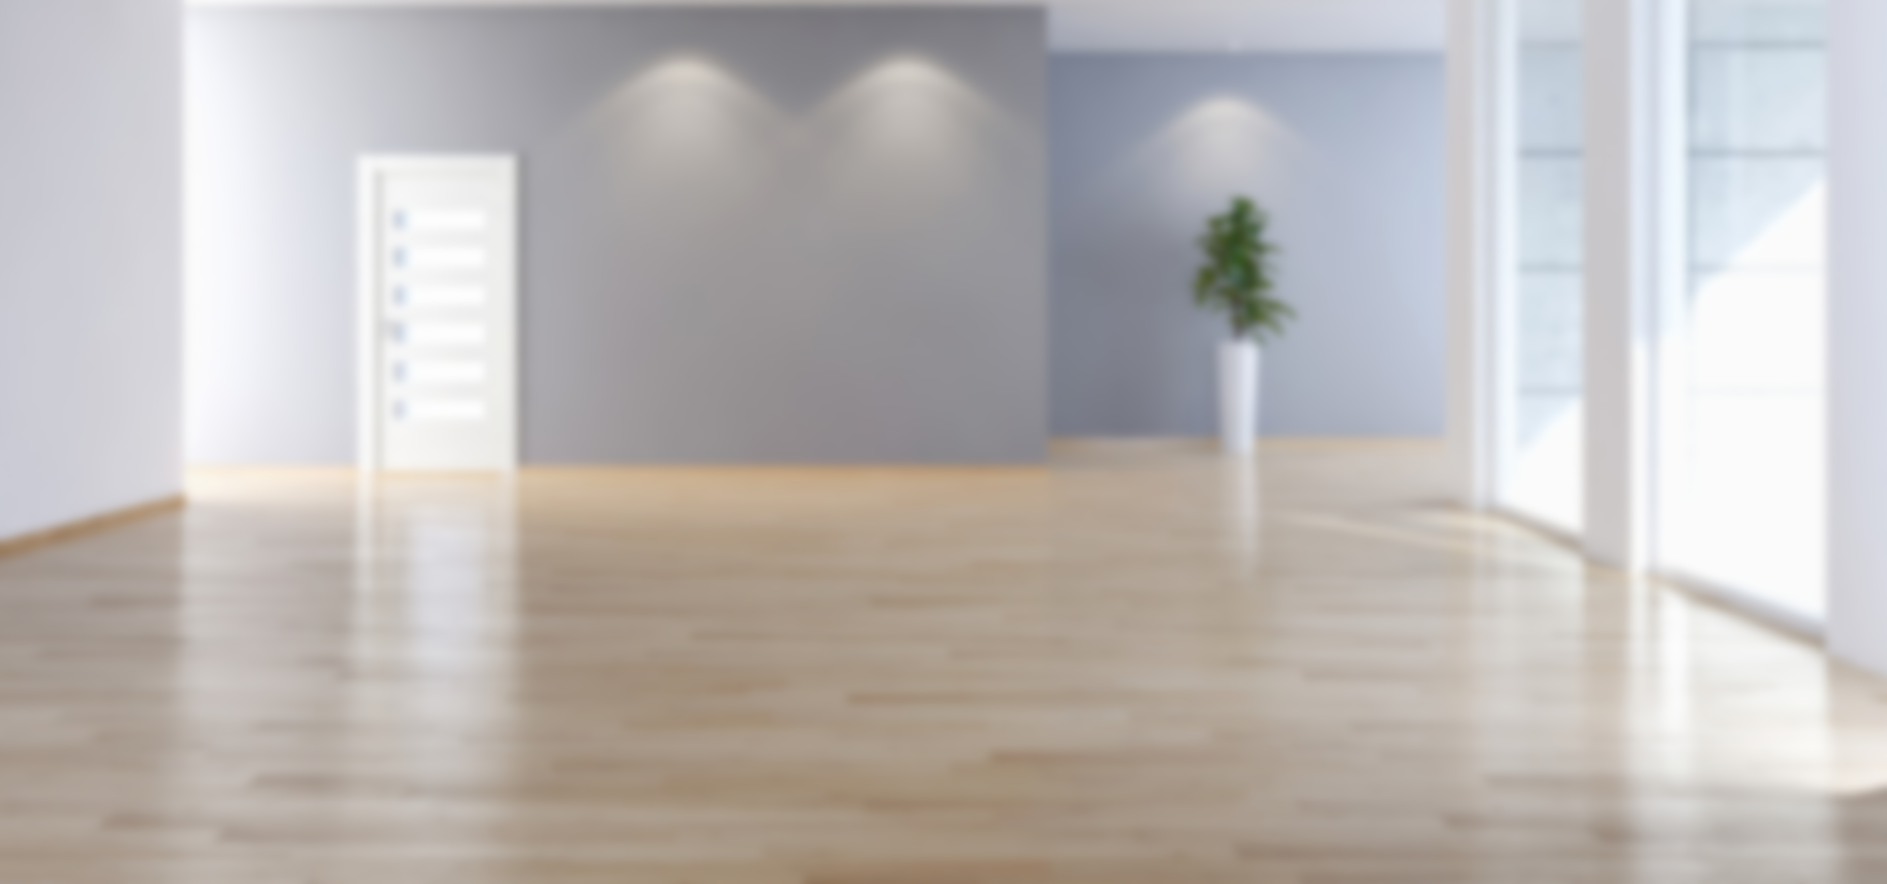




TARGET
MARKET
WHEELCHAIR USERS
BULDING OWNERS

Slide 8
Total Loss Over 12 months (RM 163, 000) + Startup Cost (RM 120,100) + Variable Costs (RM 16, 900)
Asking fund = RM300, 000

Slide 9
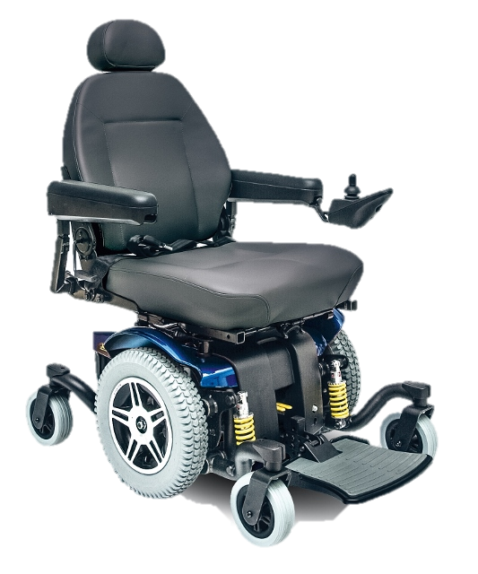

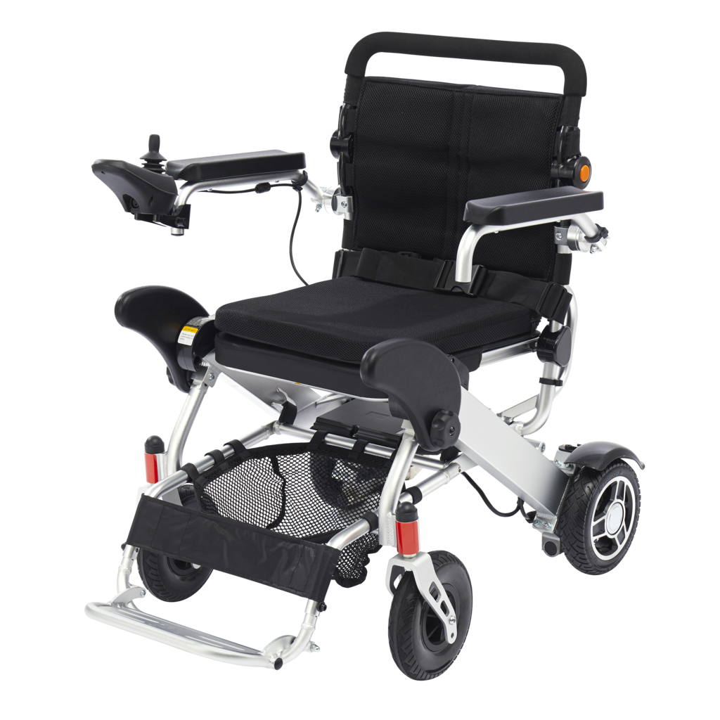
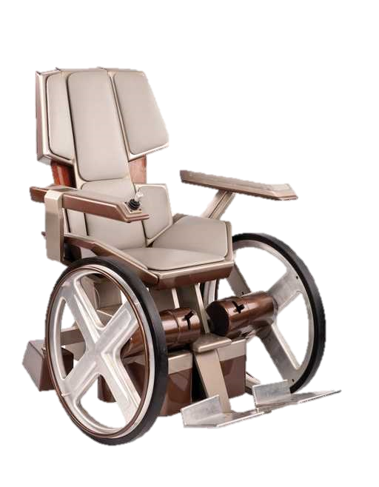
COMPETITORS

Slide 10






REVENUE MODEL
PRODUCT SALES
INITIAL
SYSTEM SETUP
WEBSITE
ADVERTISEMENTS
MONTHLY
MAINTENANCE

Slide 11





PARTNERSHIP
WITH JKMM
VIDEO
ADVERTISING
PAID SEEDING
SMALL
IMPLEMENTATION
MARKETING STRATEGIES

Slide 12
BUSINESS TRACTION
97%
Provide positive feedback
Approved by
Hospital Serdang
At least
10
Building owners in the first year
20%
Market growth
each month
Approved to apply
first implementation
To provide constant
monthly revenue
Ever expanding
market of customers
Out of around 200
wheelchair users surveyed

Slide 13

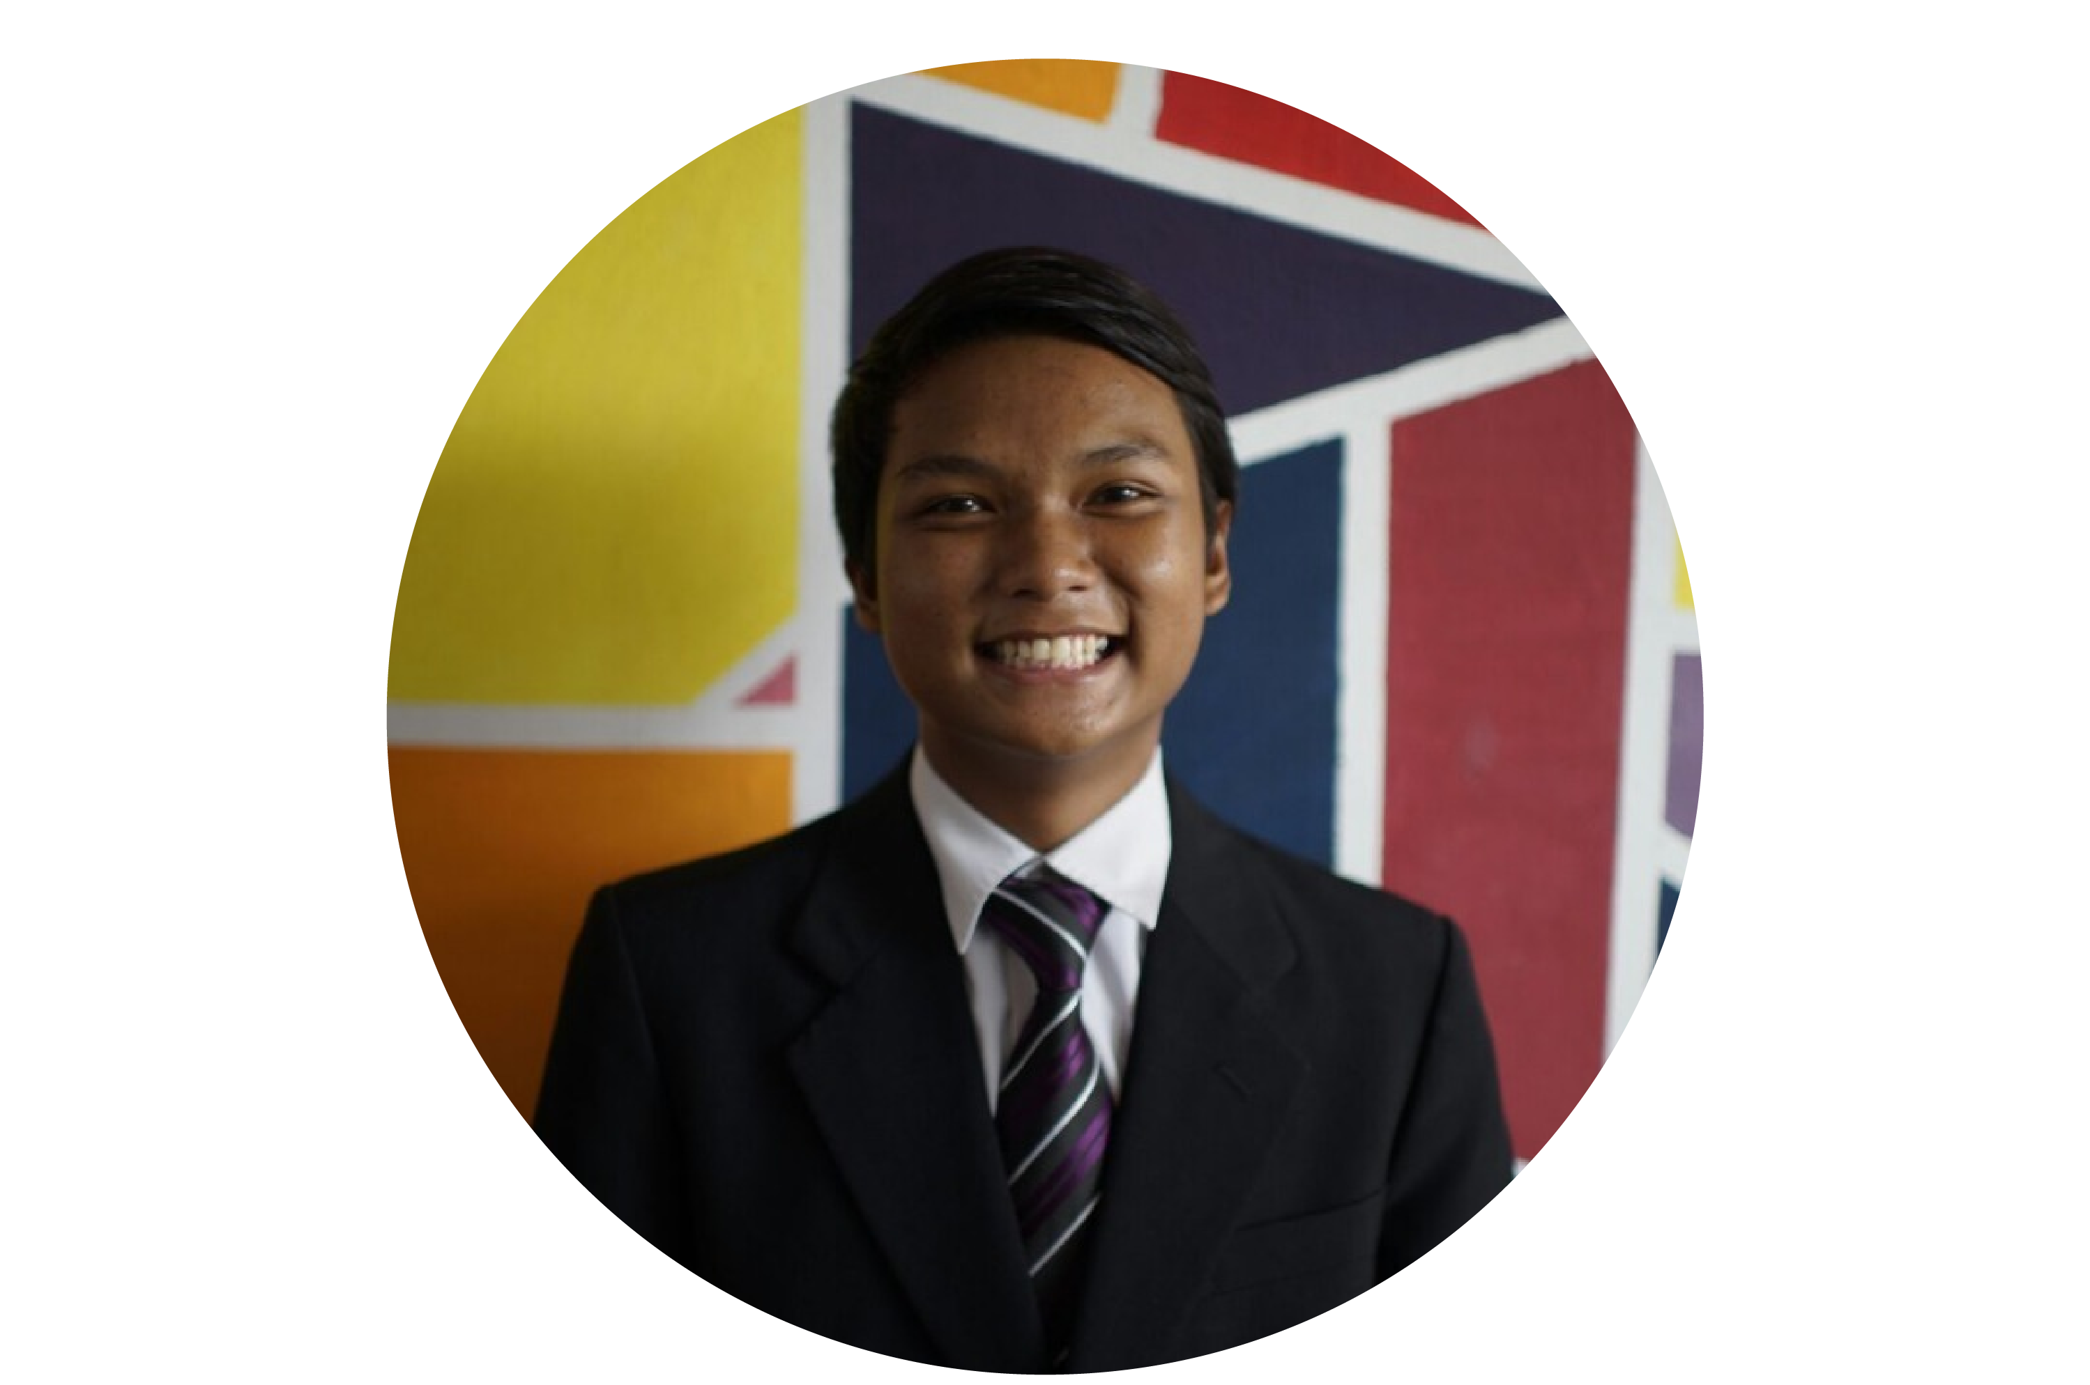
AHMAD DAHAQIN
BIN IBRAHIM
AL-ANDZAR
BIN AZMI
.
FOUNDER
.
C0-FOUNDER

